Slide 1
MSBA 6440 | Causal Inference via Econometrics and Experimentation
Project
Effect of Incentives on learning HIV Status
Team :
Ariana Irani
Yashish Reddy
Ravi Hasyagar
Jiarui Hu

Slide 2
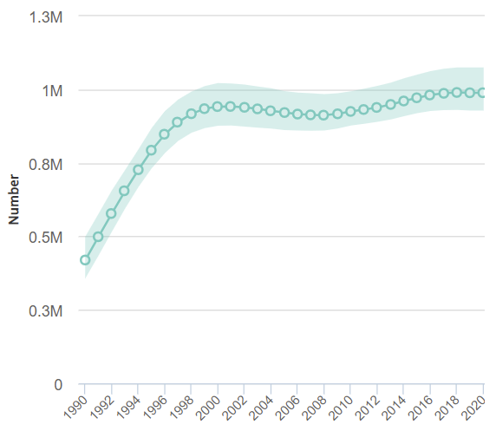


Background and Problem Statement
Over the past two decades, the HIV/AIDS epidemic has afflicted millions of individuals in Africa
Possible preventive interventions:
  Increase HIV testing
  Introduce universal testing programs, i.e., sending nurses door to door
17. 3 M
South African Govt expenditures on testing and counseling in 2004
Of all HIV program expenditures in 200, 55% were for HIV counseling and testing
People in South Africa living with HIV (all ages) in 2004

Slide 3

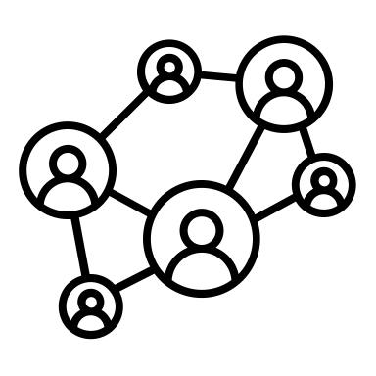
Background and Problem Statement
Common beliefs and assumptions around HIV testing
The knowledge of HIV status has positive effects on sexual behavior, preventing spread
It is difficult to get people to learn HIV status, due to psychological or social barriers

Slide 4
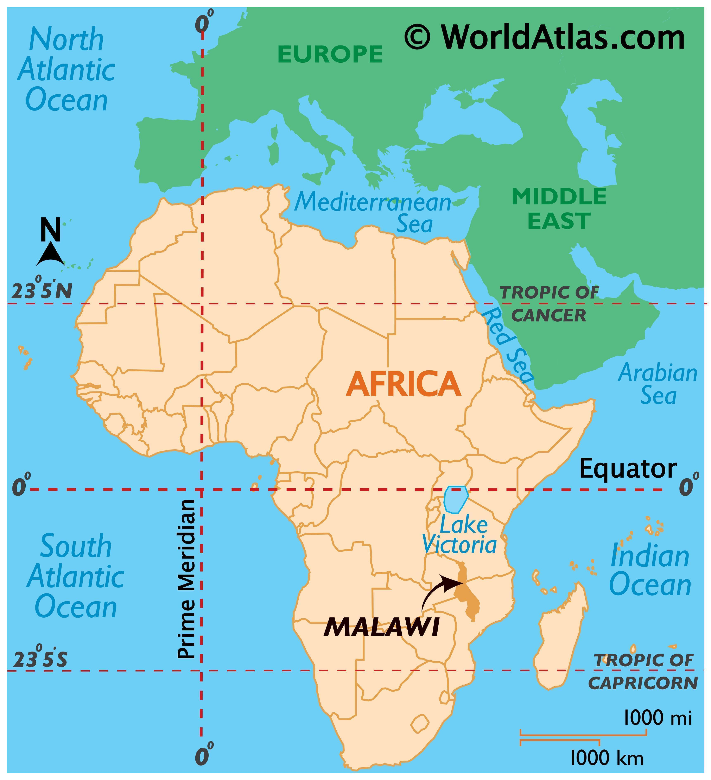


Background and Problem Statement
Common beliefs and assumptions around HIV testing
We conducted an experiment to test these assumptions
We will evaluate a field experiment conducted in rural Malawi, a country in South East Africa
In this study, respondents were offered a free door-to-door HIV test and were given randomly assigned vouchers ($0 - $3) redeemable upon obtaining their results at a nearby VCT center
The knowledge of HIV status has positive effects on sexual behavior, preventing spread
It is difficult to get people to learn HIV status, due to psychological or social barriers

Slide 5
Background and Problem Statement
Common beliefs and assumptions around HIV testing
We conducted an experiment to test these assumptions
We will evaluate a field experiment conducted in rural Malawi, a country in South East Africa
In this study, respondents were offered a free door-to-door HIV test and were given randomly assigned vouchers ($0 - $3) redeemable upon obtaining their results at a nearby VCT center
The knowledge of HIV status has positive effects on sexual behavior, preventing spread
It is difficult to get people to learn HIV status, due to psychological or social barriers
Key Question : Does providing incentives have an effect on people learning their HIV test results

Slide 6










Overview of the Data
Data Collection Brief
Men and women randomly selected from approximately 140 villages located in the Northern, Central, and Southern regions of Malawi
Approximately 25 percent of all households in each village were randomly selected to participate
Between May and August of 2004, nurses from outside each area offered respondents free tests in their homes for HIV (Samples were taken through oral swabs)
Features
Number of observations
4820
Unique Village Id
Got/Not got Result
Received /Not Received Incentive
Total Incentive
Number of features
9
Gender
Age
Distance in kilometers
HIV Results
Married or not

Slide 7




Exploratory analysis of the data
Summary Statistics
# Female
# Male
# Married
# Not Married
Number of respondents | 4820
Age range (females) | 13-84
Age ranged (males) | 11–81
Survey response rate | 67.00%
HIV test acceptance | 90.49%
Learned result | 69.66%
HIV prevalence | 6.00%
2560
2260
2544
963
# Incentive
# No Incentive
Average Age
2016
878
33

Slide 8
Experiment Set Up
Collecting HIV Test Samples
Free door-to-door tests were conducted
Providing Vouchers
Drawn from a bag randomly
Vouchers ranged from 0$ - $3
Average amount = $1.01 (equivalent to one day’s wage)
4-5 Months later
Voluntary Counseling and
Testing Center
Villages were grouped into zones
Test Center was randomly selected for VCT center

Slide 9
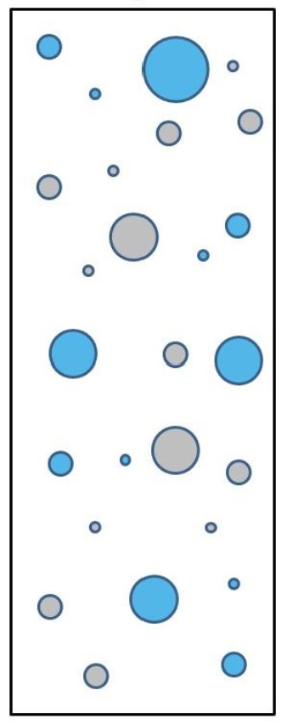
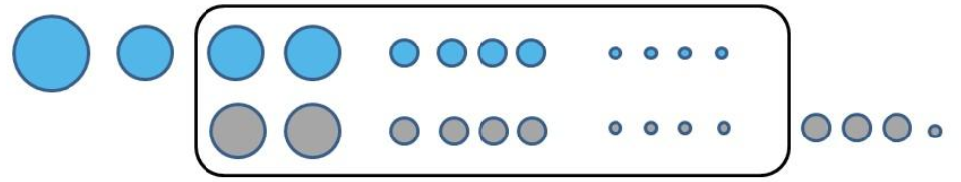
Propensity Score Matching
We noted that the original data fails randomization tests for covariate Age. The original data is unbalanced, so we can use propensity score matching to reduce confounding biases
Control Group: Subjects who didn’t get any incentive
Total number: 424
Control Group: Subjects who didn’t get any incentive
Total number: 619
PSM
Treatment Group: Subjects who got an incentive
Total number : 455
Treatment Group: Subjects who got an incentive
Total number: 2197
After propensity score matching we can see that
the matched data is random for all variables and
is balanced

Slide 10
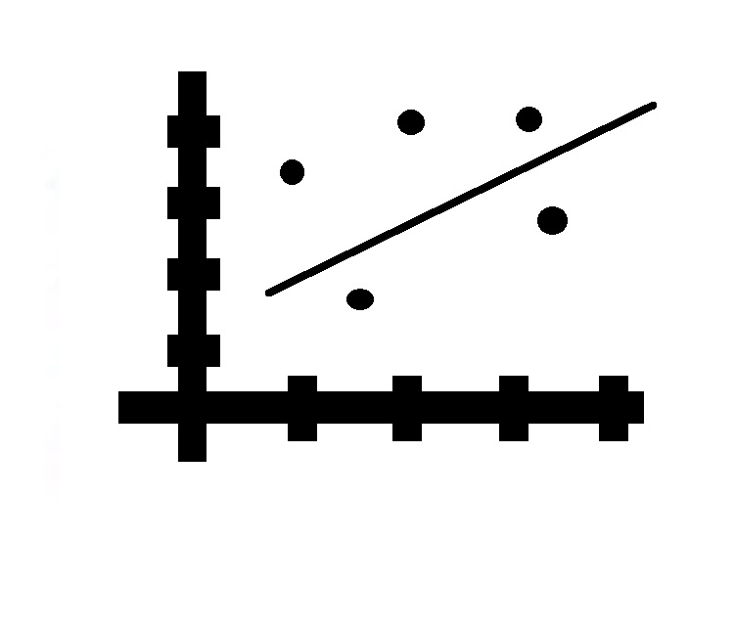
Analysis
After performing propensity score matching, we did the following:
Initially regressed age, marital status, gender, distance to the VCT center, and whether the subject got incentives over if the subject proceeded to get the result
Regressed whether the subject got incentives over if the subject proceeded to get the result
Regressed distance to VCT center over if the subject proceeded to get the result
Lastly regressed the incentive the subject got over if the subject proceeded to get the result

Slide 11

Results
Based on our analysis, below are the results we found:
Any amount of incentive increases the odds of subjects finding out the results by almost 7 times
Increasing incentive amount by $1 increases the odds of subject finding out the results by about 1.01 times.
Decreasing the distance to VCT center by 1 km, increases the odds of subject finding out the results by about 1.2 times

Slide 12

Implications
Since incentives increase the odds of a subject finding out their test results, long term programs should be developed to provide incentives to all patients who are getting test for HIV
Since decreasing the distance to VCT increases the odds of subject finding out the results, infrastructure should be set up to increase the number of centers. This would make the centers more accessible for the subject to get the results
These two combined with each other could be an effective HIV prevention strategy in rural Malawi

Slide 13

Limitations & Threats to Causality
Possible Threats to Causality :
Omitted variable bias : There could be other factors, such as behavior of VCT center staff due to which a subject might be wary of getting the results
Selection Bias
The design of this experiment avoids selection bias because it randomized:
            Individual incentives to learn HIV status
            Location of VCT centers where HIV results were available
Measurement error: There is no measurement error as experiment also measured actual post-test attendance at centers to obtain results
Simultaneity: There can be no source of simultaneity

Slide 14
Thank you!

